Slide 1
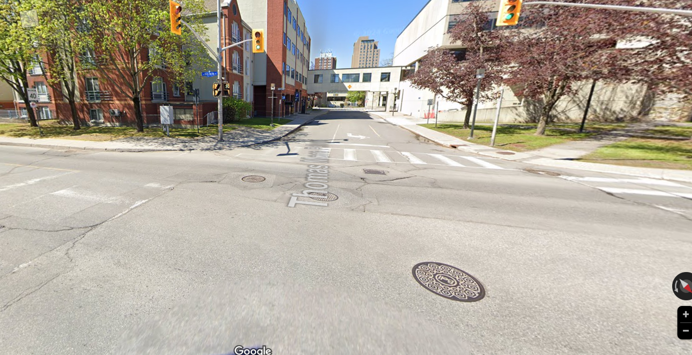
Enter Campus – King Edward / Osgoode –Thomas More intersection

Slide 2
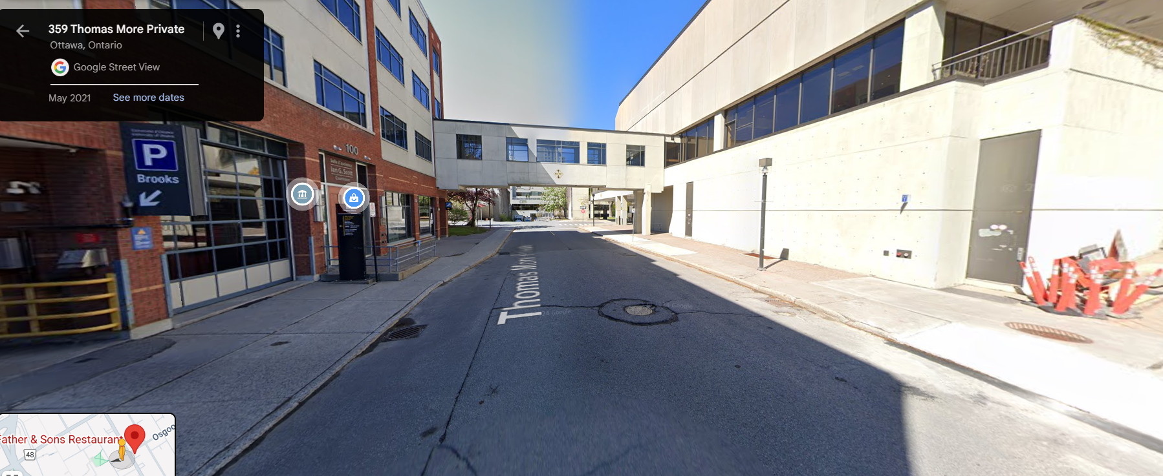
Parking garage (Brooks Garage) on left --- or WALK STRAIGHT.

Slide 3
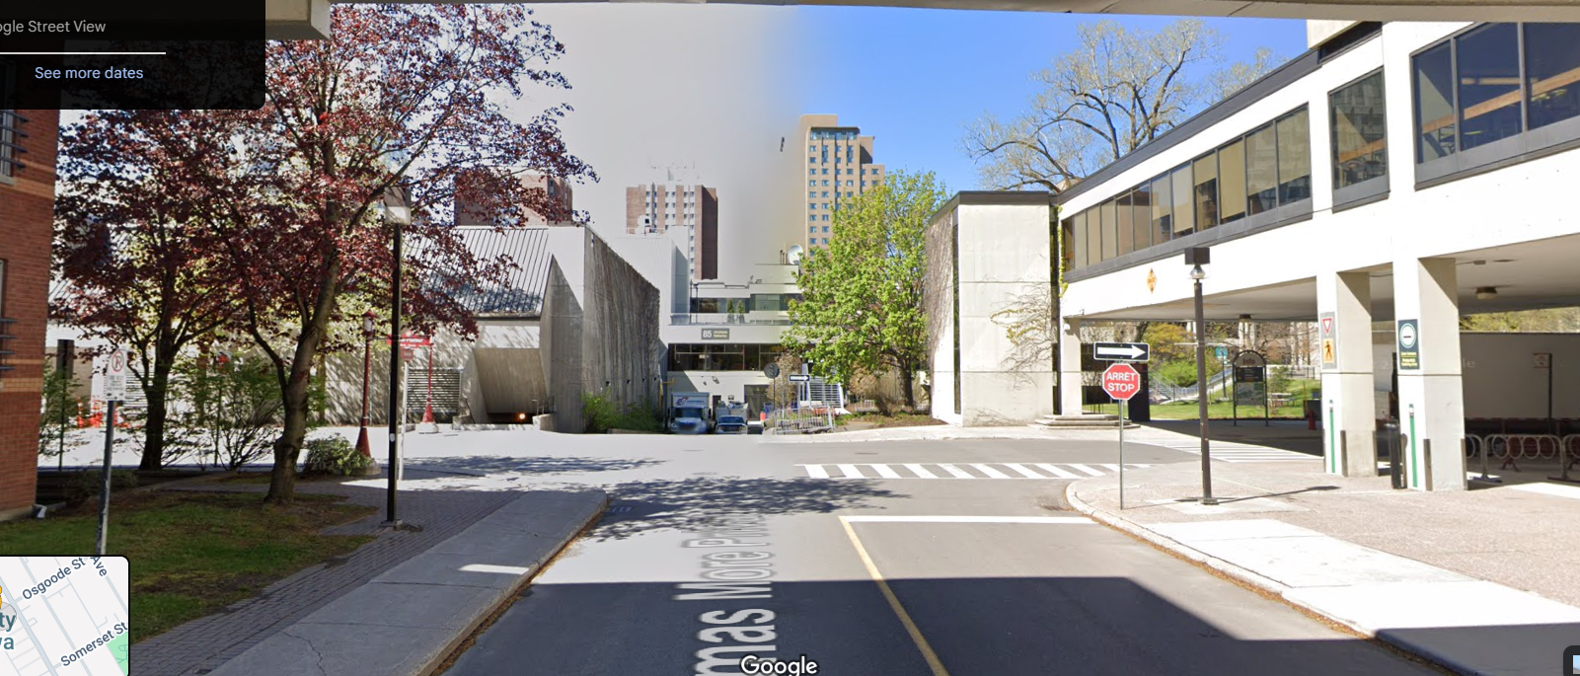
If walking – turn left on Louis-Pasteur (at T in Road)

Slide 4
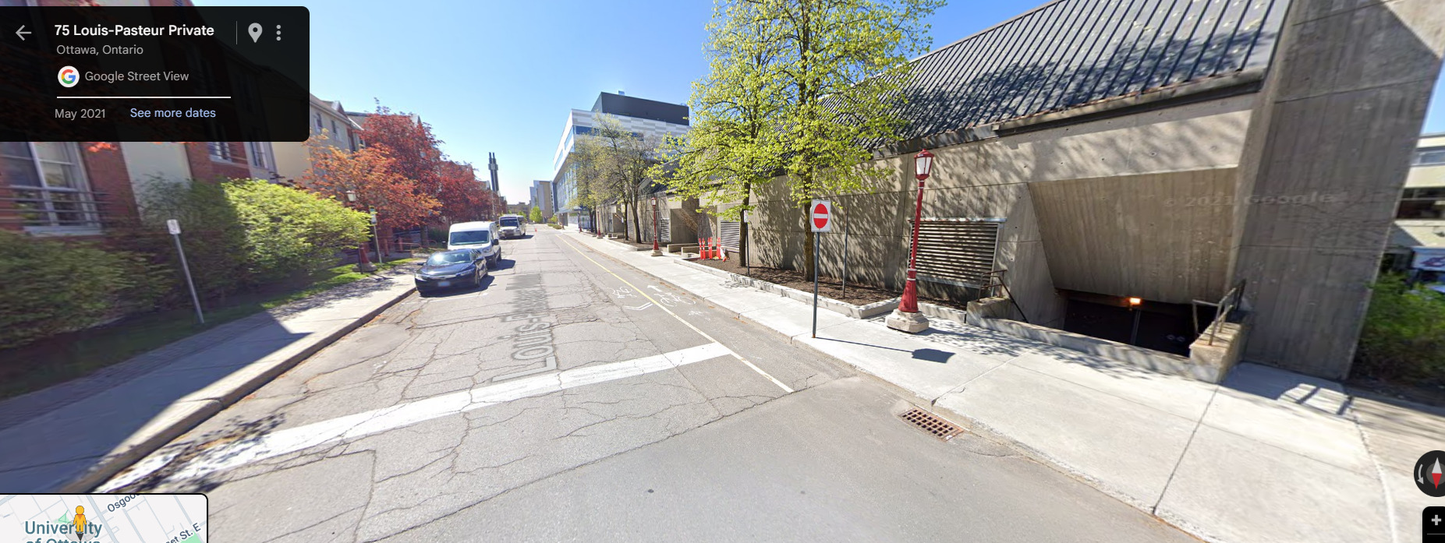
Walk down Louis Pasteur. Take first right once you pass the building that is on your right.

Slide 5
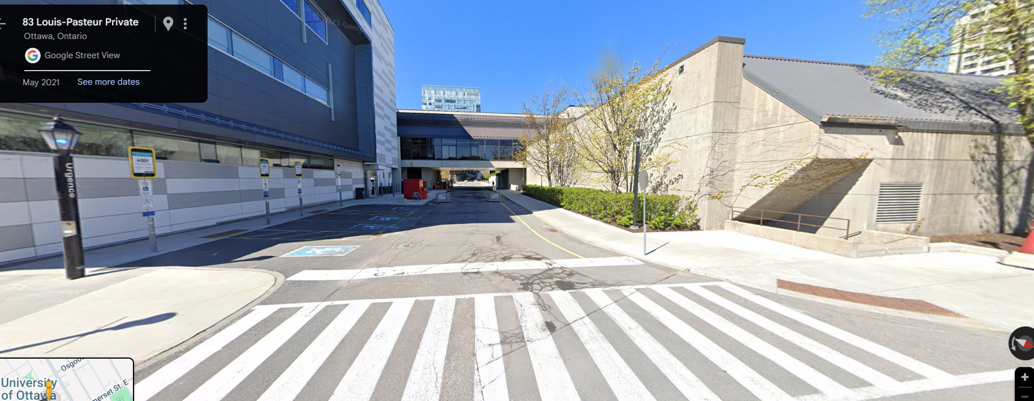
Walk straight (going under the overpass you see in the photo) until you see stairs going up – on your right. That is the entrance to Montpetit Hall

Slide 6
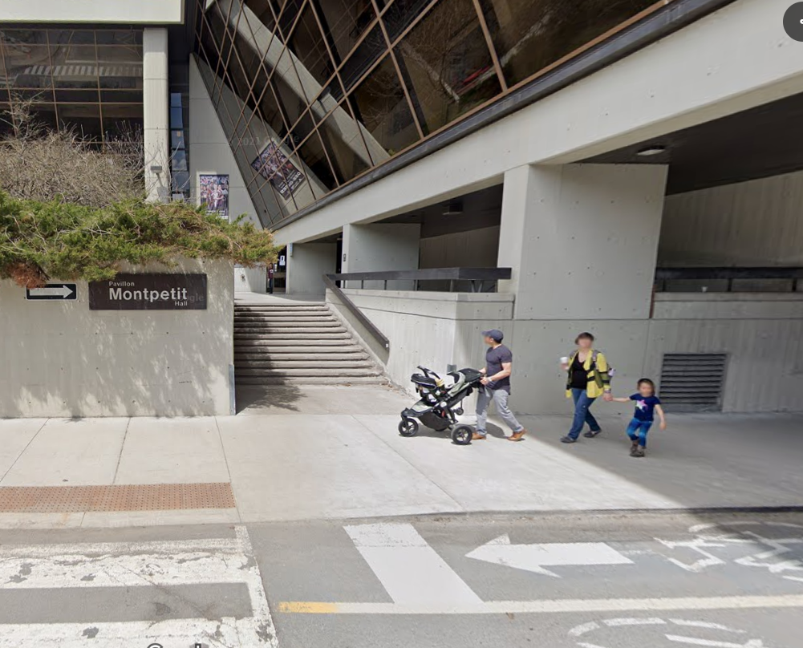
Walk straight until you see stairs going up – on your right. That is the entrance to Montpetit Hall. Main door is on your right. Enter building. The welcome desk will be straight ahead. GO down the stairs on your left to the basement. That is the gym

Slide 7
